Slide 1
Business and political leadership
By (student name)

Slide 2
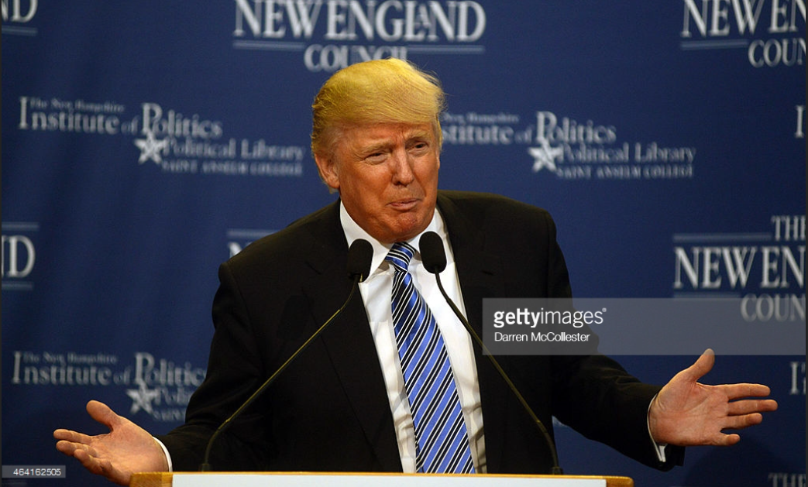
Difference
There is a growing phenomenon of Businessmen becoming Politicians
President Donald Trump is one of them.

Slide 3
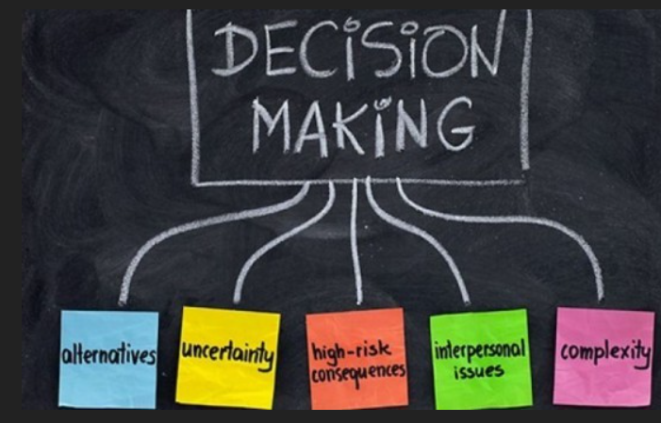
Decision-Making
Business decision-making process is not complex
decisions are made with consideration of business interest i.e goals and vision

Slide 4
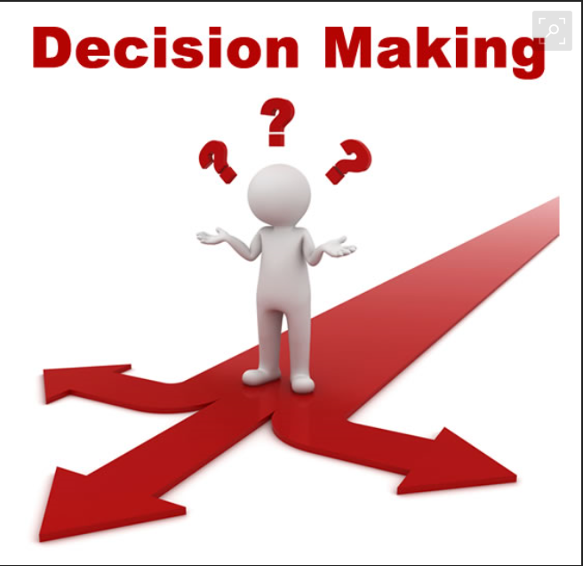
Decision-making (political)
In politics, the decision is more complex
Analysis has to be made
Outcome of the decision is not predictable

Slide 5

Leadership Roles and Period
Political leaders have to be elected
There is no interview like in business
One has to be a good communicator
Political leadership has more obligations than a business leadership

Slide 6
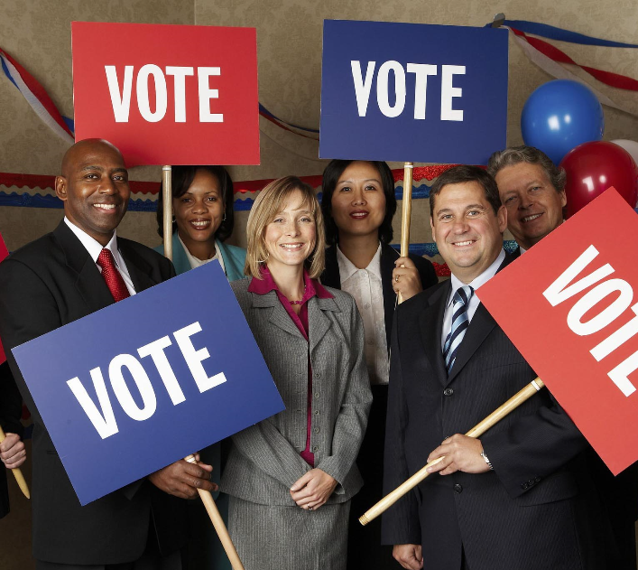
Attaining leadership
Leadership is attained both in politics and business
Politicians are voted in leadership positions
Business leaders are appointed and promoted

Slide 7

Attaining Leadership cont.
One is interviewed
Skills and experience are relevant in being a business leader
One can be a self-made leader
They must be good managers and able to maximize profits

Slide 8
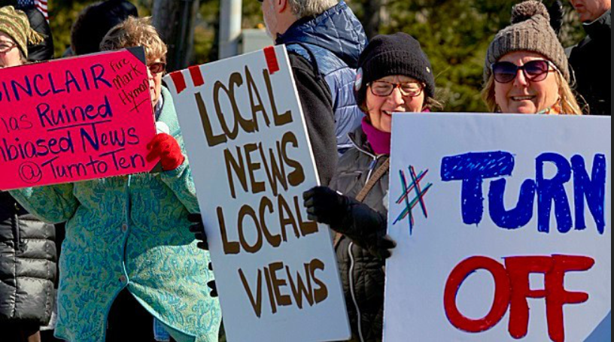
Similarities
they both have shared challenges like media dynamics
Criticism in media platforms
Decisions made in both have consequences
Public critiques the leadership of a business or tye government

Slide 9
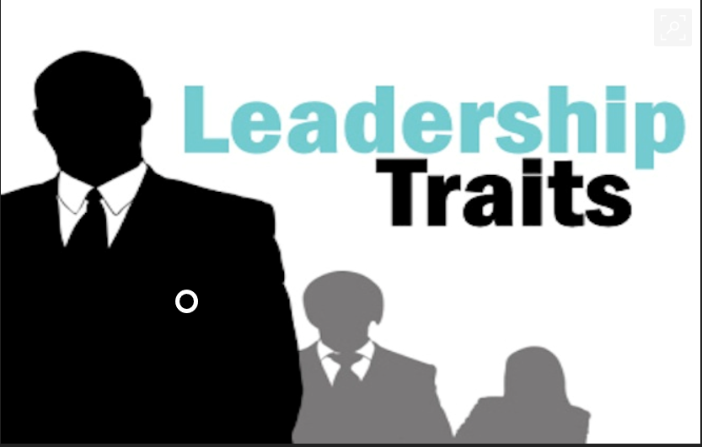
traits
Leadership styles are the same in both
Eventually, a leaders has to learn how to influence
A leader has to transform vision into realty and
In both, one is always faced by conflicting decisions

